Slide 1
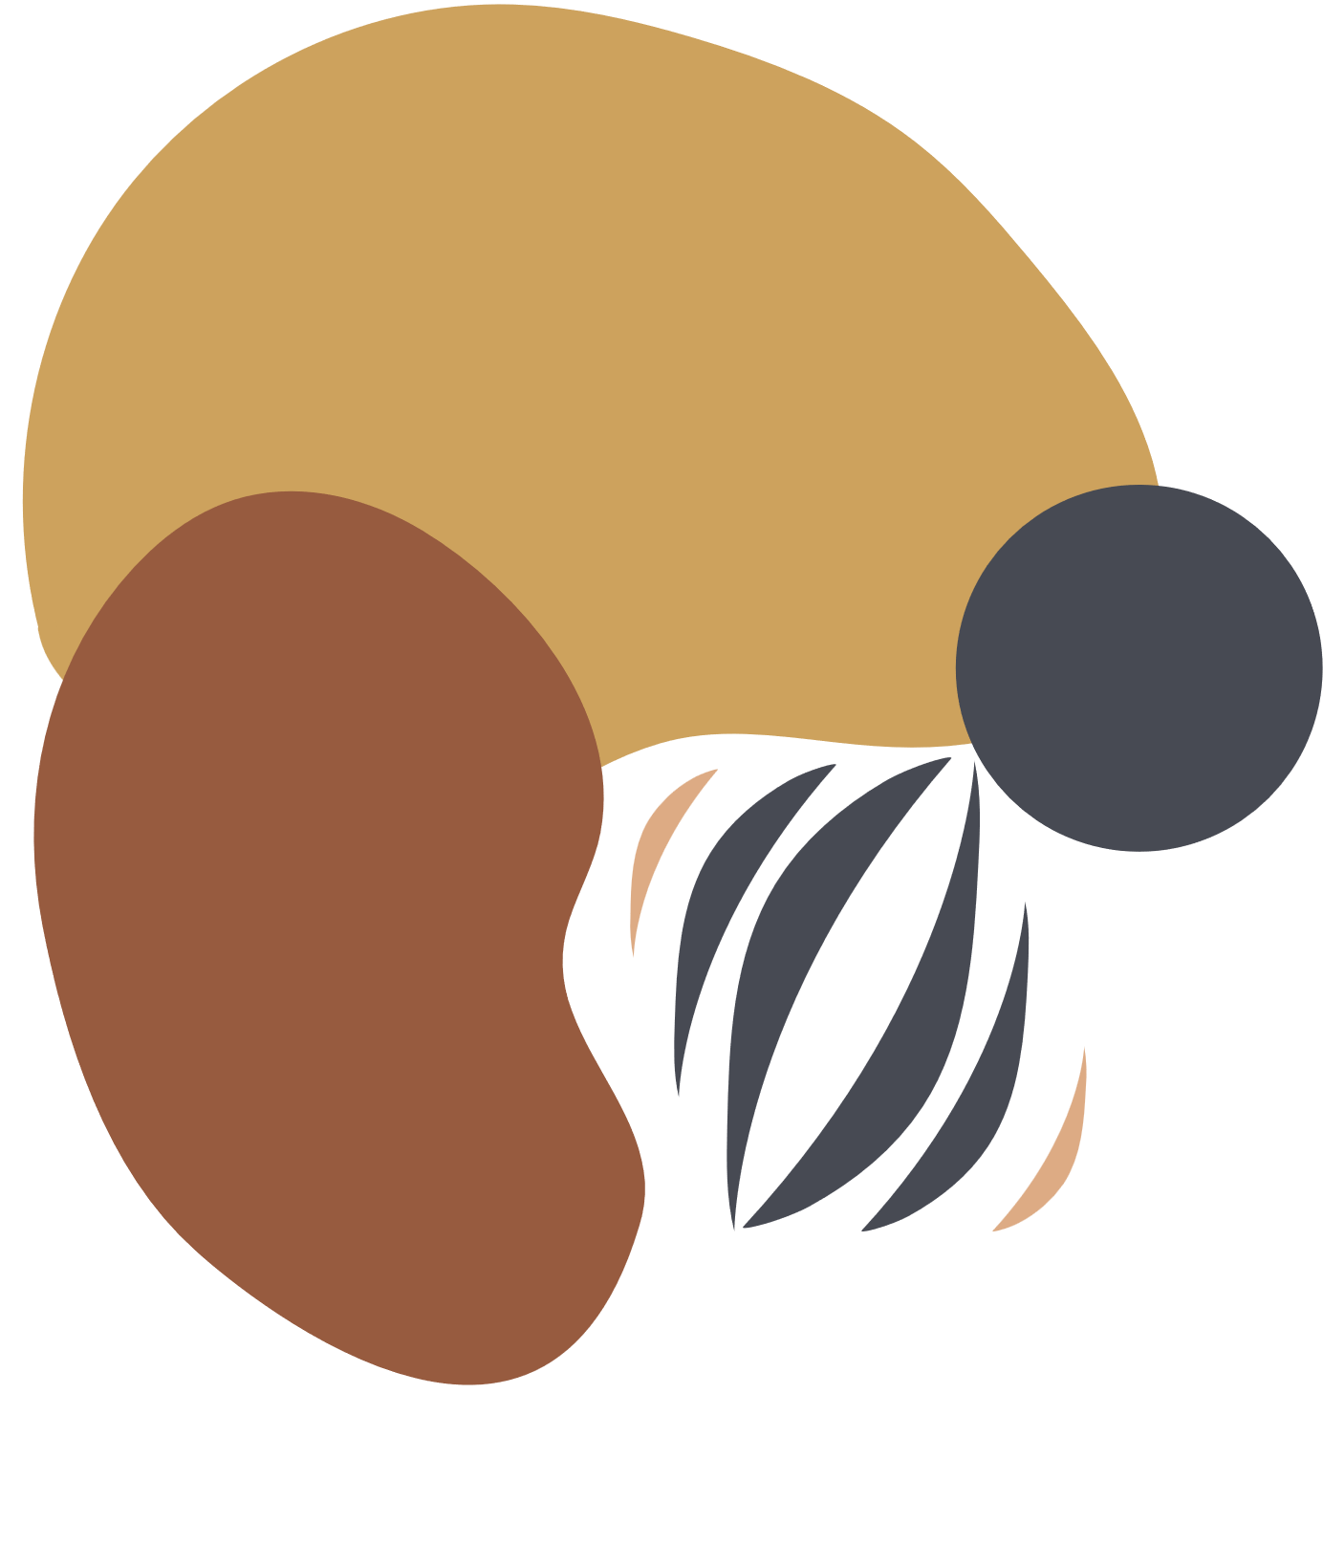


POSE AI
ROUND - III

Slide 2

Model
I
MEDIAPIPE
MediaPipe is a real-time system for detecting and tracking human body poses by identifying key points on the body, such as the head, shoulders, elbows, knees, and other joints. It is suitable for a wide range of applications such as fitness tracking, sports analysis, motion capture, and augmented reality (AR).

Slide 3
Model
II
MULTIPOSE
MultiPose refers to the process of detecting and tracking the body poses of multiple individuals in an image or video. Unlike single-pose detection, where only one person's body landmarks are detected, MultiPose detects keypoints for several people simultaneously, making it useful for analyzing crowded scenes or group activities.

Slide 4
Model
III
MOVENET
Movenet is designed to estimate the poses of humans by detecting keypoints on the body in 2D space. It is suitable for scenarios where real-time performance is critical, such as fitness apps, sports analysis, and augmented reality (AR).

Slide 5
Model
IV
OPENPIFPAF
MediaPipe is a real-time system for detecting and tracking human body poses by identifying key points on the body, such as the head, shoulders, elbows, knees, and other joints. It is based on a bottom-up approach, where it first detects body keypoints and then assembles them into full poses.

Slide 6
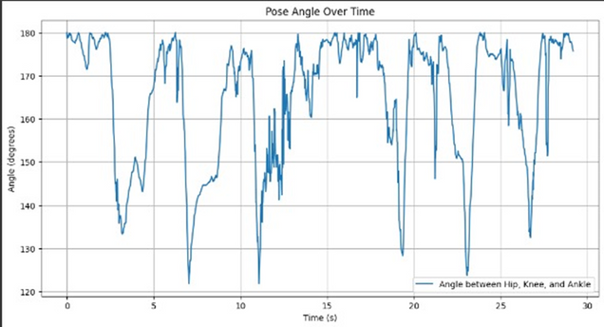
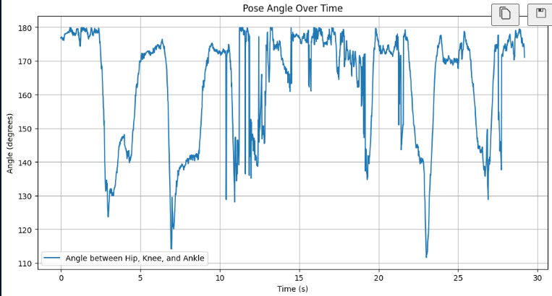
OUTPUT GRAPH
1
2

Slide 7
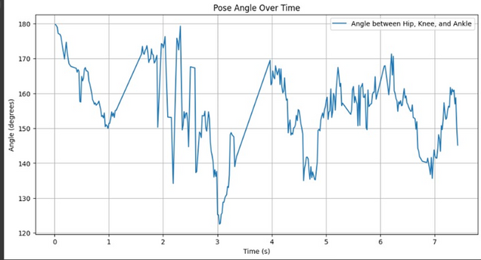
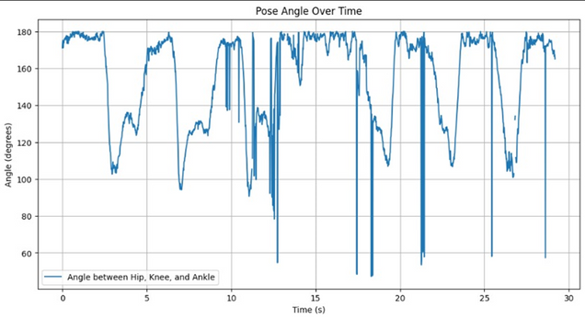
OUTPUT GRAPH
3
4

Slide 8
DRAWBACKS OF MEDIAPIPE
Single-Person Focus: It struggles with detecting multiple people in the frame, especially in crowded or overlapping scenarios.
Limited 3D Estimation: Its 3D pose estimation capabilities are very limited.
Limited Customization: Customizing or fine-tuning the pre-trained models for specific use cases is difficult.
Edge Case Failures: It struggles with poses where parts of the body are out of view or occluded by objects or other people.

Slide 9
DRAWBACKS OF MULTIPOSE
High Computational Cost: MultiPose detection requires more computational power compared to single-person pose detection.
Accuracy in Crowded Scenes: As the number of people increases, the model may confuse keypoints between individuals.
Pose Quality Deterioration: In cases of occlusion or overlapping people, the accuracy of the keypoint localization can degrade significantly.

Slide 10
DRAWBACKS OF MOVENET
Limited to 2D Pose Estimation: MoveNet only detects 2D keypoints, which limits its use in applications requiring depth or spatial understanding.
Single-Person Focus: The Lightning model is optimized for single-person detection, so it struggles where multiple people need to be tracked.
Performance on Occluded Poses: MoveNet can struggle to detect keypoints accurately when parts of the body are occluded or partially out of frame.

Slide 11
DRAWBACKS OF OPENPIFPAF
Slower Performance: It typically requires powerful hardware like GPUs to achieve real-time performance.
Complexity in Deployment: Deploying OpenPifPaf in production or real-time applications can be challenging compared to more lightweight models.
Overhead in Crowded Environments: The accuracy can suffer in very crowded environments.

Slide 12
DIFFICULTIES
MediaPipe: Struggles with multi-person detection, limited customization options, performance issues in complex images.
MultiPose: High computational demands, difficulties with keypoint plotting in crowded scenes, and real-time performance challenges with multiple people.
MoveNet: Limited to 2D pose detection, struggles with fast movements, and difficulties in multi-person tracking.
OpenPifPaf: Complex implementation and deployment, and difficulties in handling crowded scenes efficiently.

Slide 13
USES
Fitness and exercise monitoring
Sports performance analysis
AR/VR gaming
Sign language recognition
Surveillance and security

Slide 14
THANK YOU
By CTRL ALT Elite

